Slide 1
Docker Compose: ASP.NET Core with SQL Server
By: Snehasish Chowdhury(Date: 10-02-2021)

Slide 2
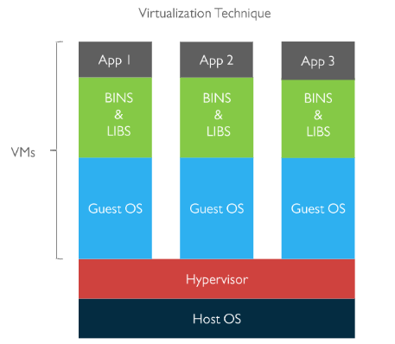
Virtualization
It is the technique of Importing a Guest operating system on top of a Host Operating System
Advantages:
Multiple Os Image in same machine
Easy maintenance & recovery
Lower total cost of ownership
Disadvantages:
Multiple VM lead to unstable performance
Hypervisor are not as sufficient as host OS
Long boot-up process

Slide 3
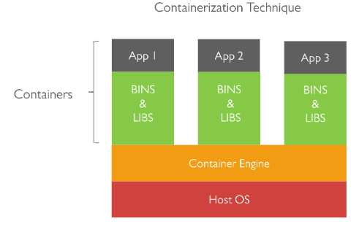
Containerization
It is the technique of bringing virtualization to the operating system level. It is more efficient because there is no Guest OS here. It utilizes a host’s operating system , share relevant libraries and resources as and when needed unlike virtual machine.
This process packaging the application and all its dependency together in order to execute them in an efficient and hassle-free way across different environments. A single unit of this bundle package is known as Container
Advantage over Virtualization
Containers on same OS Kernel are lighter and smaller
Better resource utilization compared to VMs
Short boot up process

Slide 4
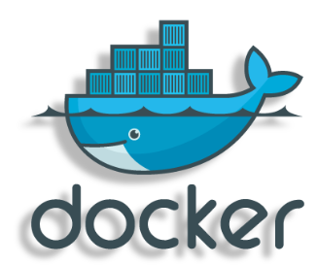
What is Docker
Docker is a tool designed to make it easier to create, deploy, and run applications anywhere by using containers
Advantage:
Allows a developer to package an application with all the requirements such as binaries libraries and other dependencies
Ensures that the application works in any environment be it Dev, Test or Production.

Slide 5
Who uses Docker
Developer: To focus only on building great software by automating the repetitive tasks of setting upand configuring the development environment
Sysadmin: To streamline the software delivery, such as develop and deploy bug fixes, new features without any road block.
Enterprise: Works in the cloud just as well as on premise; support both traditional and micro services architecture.
Case Study:
Please check the below link
https://www.mirantis.com/blog/visa-gains-speed-operational-efficiency-with-docker-enterprise/

Slide 6
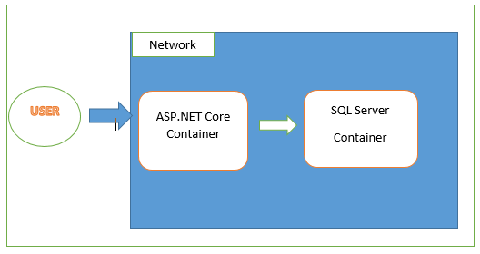
Demo
In this document, I will demonstrate how to host multi container Docker application using Linux and Docker Compose tool.
Here is the typical flow of the application. Where two container connected each other by creating there own network.

Slide 7
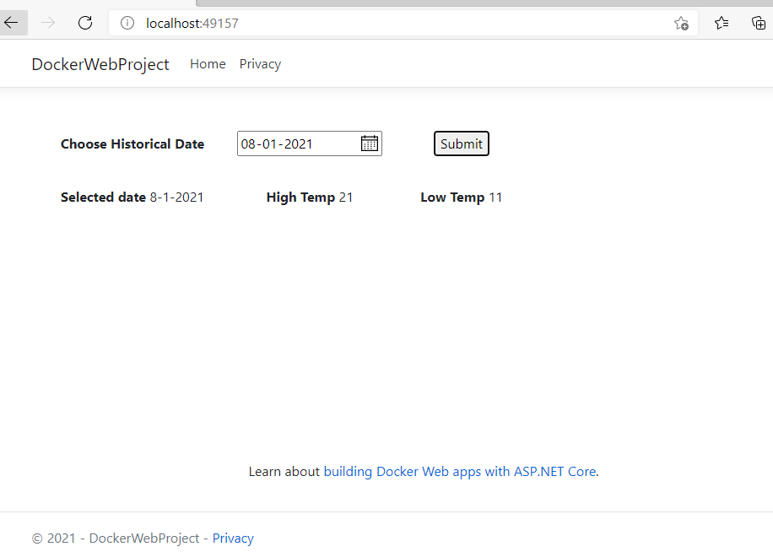
Application Description
In this sample application I have created a simple MVC web page where user can search the historical temperature records for a particular day. Historical records are stored inside Sqlserver database hosted inside container.

Slide 8
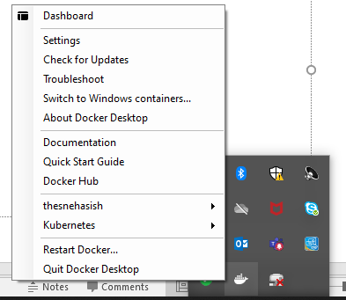
Application Development Step(WEB)
Install necessary docker tool from the official docker website.
https://hub.docker.com/editions/community/docker-ce-desktop-windows/
After installation you can see Docker icon from system tray where you can start or stop Docker engine.

Slide 9
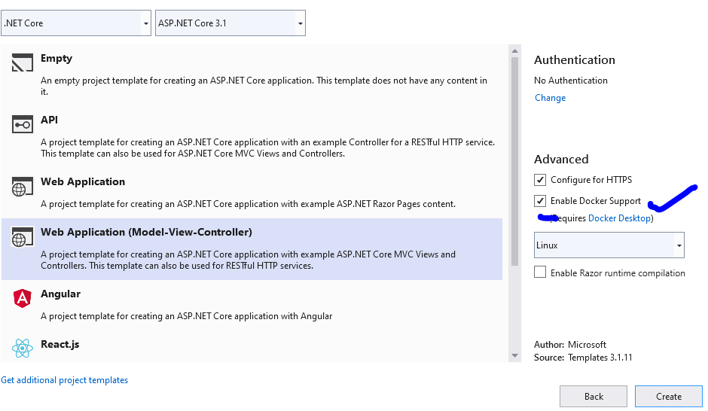
Application Development Step(WEB)
Create a visual studio MVC application after enabling Docker Support check box and Linux as container operating system.

Slide 10
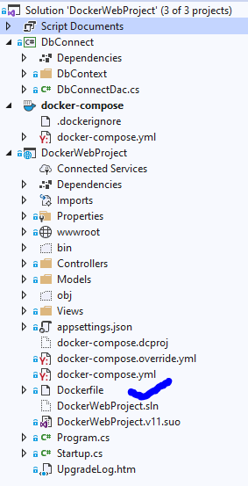
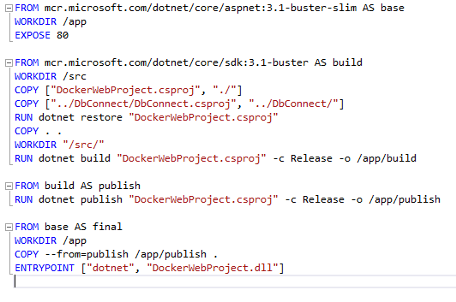
Application Development Step(WEB)
This will create docker file inside the project inside the solution. Also you can write your own Docker file with custom configuration or generate docker file later after creating project. When you build the image it will create image for our application.
Here is the docker file for this application

Slide 11
Application Development Step(WEB)
Now if we run the application it will create docker image for the application
To check the running image type command> docker image ls
This will show list of all installed docker image
To check the running container , type command> Docker ps
This will list all running docker container
I have created custom DbConnect project for conncting and writing DB logic.
Next we need to setup some configuration to connect application with database.

Slide 12
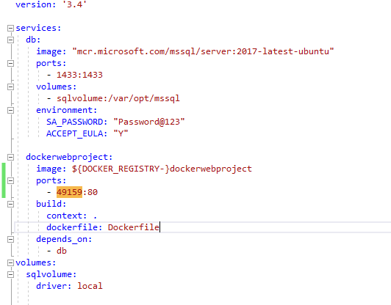
Application Development Step(DB)
Now you need to create a docker compose file where we will set up Data base container hosting configuration. i.e. running multiple container inside same network.
To do so Right click on the project> Add> Container Orchestrator Support> select Docker Compose
This will create docker-compose project with docker-compose.yml file.
Write the following in the file, and make sure to replace the password in the SA_PASSWORD environment variable under db below. This file defines the way the images interact as independent services.

Slide 13

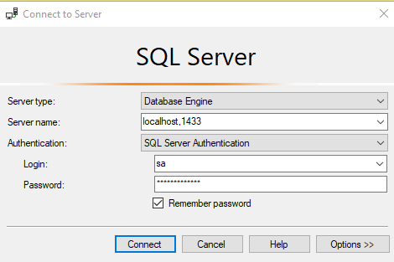
Application Development Step(DB)
Now application is ready. Run docker compose project which will run the docker-compose.yml file and start the application.
To Connect database write following connection string into your code
Persist Security Info=False;Server=db,1433;Database=MyTestDb;User=sa;Password=Password@123;
To connect sql server running into docker container from the host machine, we should connect as follows. Here the password is same as we already configured.

Slide 14
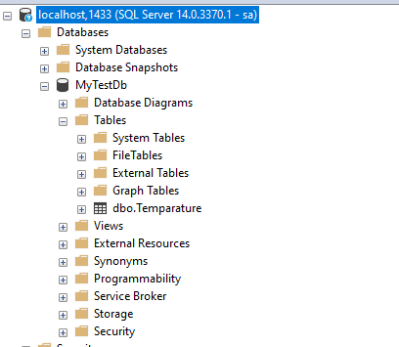
Application Development Step(DB)
Now we need to configure data base, based on our requirement as like follows

Slide 15
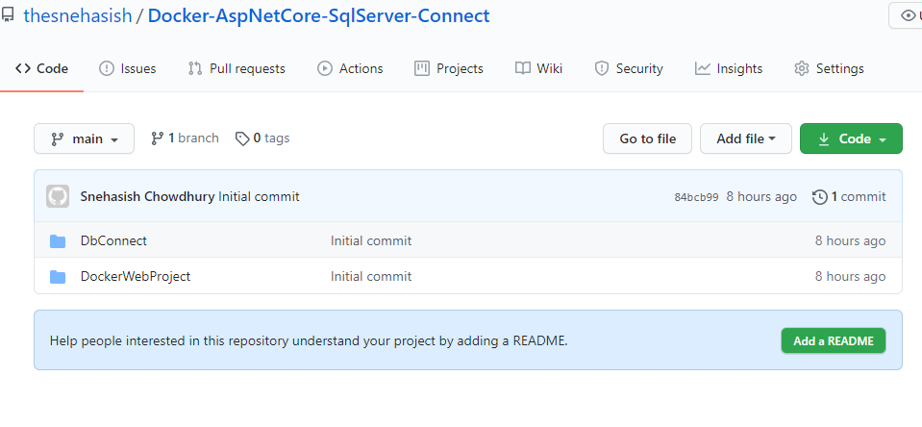
Code Base
I have uploaded the code base into Github. Please download it and modify the code as per your requirement. Please fill free to comment or directly ask me if you have any confusion. Also let me know if you want me to discuss any other topic related to docker.
https://github.com/thesnehasish/Docker-AspNetCore-SqlServer-Connect

Slide 16
EOF

